Slide 1




REVOLUTIONIZING THE CUSTOMER EXPERIENCE: ADVANCED INTELLIGENCE WITH GENAI ENABLED AWS CONNECT
MSBA 2024 TEAM 3
Allison Liu, Harsha Podapati, Skylar Pu, Avanindra Singh, Riley Uecker
(A ~ Z)

Slide 2


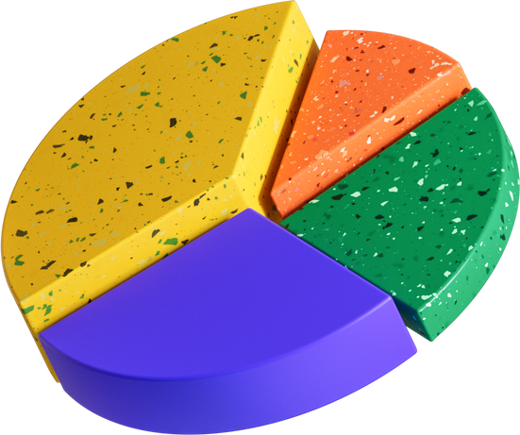
TODAY’S AGENDA
Problem Statement: Customer service center cannot address a substantial influx of user queries with exceptional quality responses.
Solution: Implementing GenAI with AWS Connect to provide the company's customer service center with the best assistant.
Recommended Workflow

Slide 3
SOLUTION MAP
ADD A MAIN TOPIC
Add a
related idea
Add more
sub-ideas

Slide 4

Nowadays, every company places a strong emphasis on creating top-notch customer service.
BUSINESS PROBLEM
However, delivering high-quality customer service is hard, stemming from the inability to quickly access relevant information and efficiently resolve customer queries.
Through our research, we have utilized GenAI enabled AWS Connect
to streamline information access.

Slide 5
Cutting Operational cost
Companies don’t need to spend a lot of money training customer agents
BETTER
THAN BEFORE
Improve scalability
Allow more simultaneous customer interactions with Gen AI and AWS connect.
Post-contact processing
Managers can easily summarize what happened after the call

Slide 6


Using Real time Customer Voice Calls As Input
Key Technical Aspects
Input Handled By GenAI enabled Lex chatbot along with Wisdom integrated AWS Connect
Customer Query Resolution & Real Time Recommendations To Agents

Slide 7

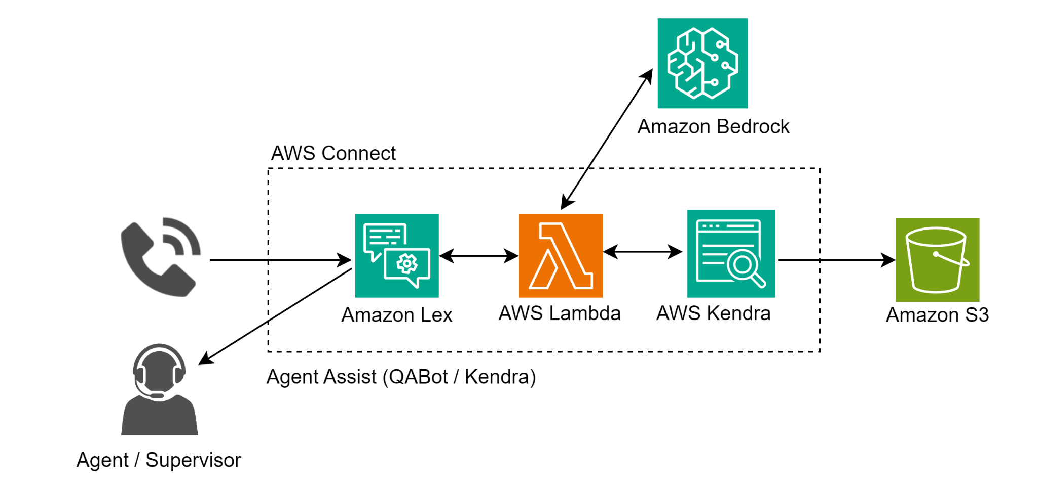
AWS
WORKFLOW

Slide 8
Overview of Data Sources, Types, and Characteristics
(Business
Value)
Approach, Processes, Tools, and Methodology
Video Demonstrations

Slide 9
Key Insights and Future Directions
How does GenAI with AWS Connect contribute to the reinforcement of 'big data'?
Offering cost-effective solutions for handling big data, as businesses can scale resources up or down as needed.
What is the real benefit of GenAI with AWS Connect?
Using Gen AI the service can be scalable to multi regions and be available 24/7. Responses would be instantaneous and reduces wait time for customers.
What is the potential direction or enhancement in the future?
The next steps, would be to have the LLM directly give responses to the Human Agent on the call. Make the responses be more personalized for the customer.
Notes:
content

Slide 10
Q&A

Slide 11
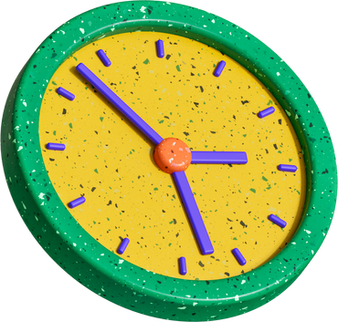



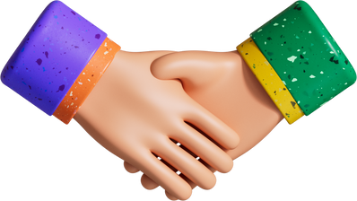



RESOURCE
Page
Use these design resources
in your Canva Presentation.
Happy designing!
Don't forget to delete
this page before presenting.

